Slide 1



PRISON MANAGEMENT SYSTEM USING CHAINING
RNS Institute Of Technology
Channasandra, Dr. Vishnuvardana Road Bengaluru-560 098
Department of Information science
FS MINI PROJECT
SUBCODE : 18ISL67
Faculty Incharge,
Vinutha G K
Assistant Professor
Dept. of ISE, RNSIT
Submitted by,
1RN20IS064 – JEEVAN NY
1RN20IS083 – MAITHREYA TM

Slide 2

CONTENTS
Abstract
Introduction
Functionalities used
Indexing
Results
conclusions
Future Enhancement

Slide 3

ABSTRACT
The Prison Management System is a program designed to manage prison and inmate data using hash tables and linked lists.
This system allows users to perform various operations such as adding prisons and inmates, searching for prisons and inmates, and deleting prisons and inmates.
The system ensures data integrity and provides efficient retrieval and storage of information.
Data integrity is ensured through input validation mechanisms that prevent duplicate IDs from being entered.
Additionally, the system automatically removes associated inmates when a prison is deleted, simplifying administrative tasks.

Slide 4
INTRODUCTION
The Prison Management System is a File Structure application designed to streamline and automate the management of prisons and inmates.
It provides a convenient and efficient way to add, search, and delete prison and inmate records, ensuring accurate and up-to-date information.
The system utilizes hash tables for fast retrieval and storage of data, optimizing performance and scalability.
This project aims to enhance the overall management process of prisons, improving the efficiency and accuracy of record-keeping and facilitating better decision-making.

Slide 5
FUNTIONALITIES USED
Prison Functions:
addPrison:Allows the user to add a new prison by providing the ID, name, and location. It checks for duplicate prison IDs and maximum linked list length limit before adding the prison.
displayPrisons: Displays the details of all prisons in the hash table.
searchPrison: Allows the user to search for a prison by its ID and displays its details if found.
deletePrison: Allows the user to delete a prison by its ID. It deletes the associated inmates and updates the hash tables and files accordingly.

Slide 6
FUNTIONALITIES USED
Inmate Functions:
addInmate: Allows the user to add a new inmate by providing the ID, name, and the ID of the prison they belong to. It checks for duplicate inmate IDs, existing prison ID, and maximum linked list length limit before adding the inmate.
displayInmates: Displays the details of all inmates in the hash table.
searchInmate: Allows the user to search for an inmate by their ID and displays their details if found.
deleteInmate: Allows the user to delete an inmate by their ID and updates the hash tables and files accordingly.
countEntriesInFile: Helper function to count the number of entries in a file.

Slide 7
INDEXING USED
Chained Progressive Overflow:
Chaining is a popular technique used to handle collisions in hash tables. When two or more keys map to the same hash value, collisions occur. To resolve these collisions, chaining utilizes linked lists.
In chaining, each slot in the hash table contains a linked list of elements that have the same hash value. When a collision occurs, the new element is appended to the linked list associated with the corresponding slot. This allows multiple elements to be stored in the same slot, maintaining a separate chain for each hash value.
Chaining provides a flexible and efficient way to handle collisions because it allows an arbitrary number of elements to be stored in each slot.

Slide 8

RESULTS
This Photo by Unknown Author is licensed under CC BY-SA

Slide 9
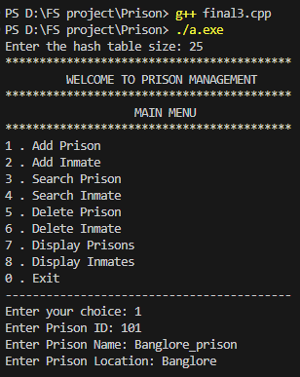
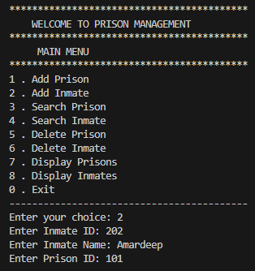
Add function
Add Prison
Add Inmate

Slide 10
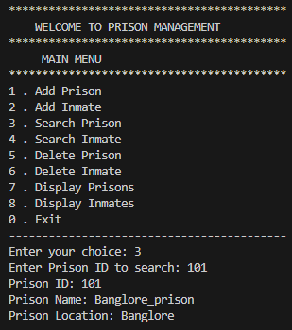
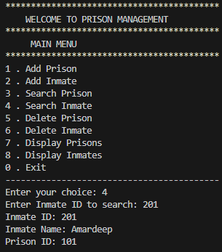
Search function
Search Prison
Search Inmate

Slide 11
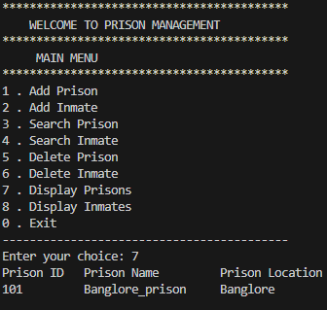
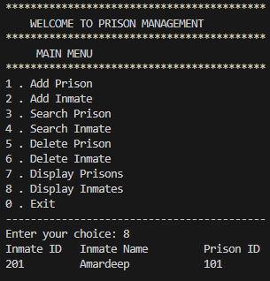
Display function
Display Prison
Display Inmate

Slide 12
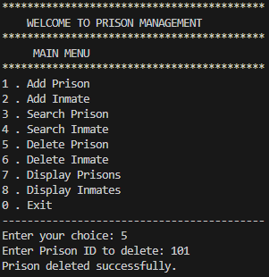
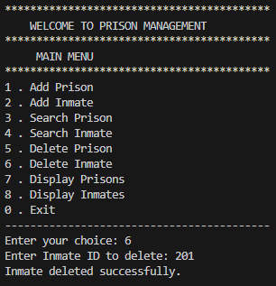
Delete function
Delete Prison
Delete Inmate

Slide 13
CONCLUSION
The code implements a Prison Management System using a hash table.
It allows adding, searching, and deleting of prisons and inmates.
Input validation ensures unique IDs for prisons and inmates.
The code sets limits for the hash table and linked list to prevent exceeding capacity.
File I/O functions save and load data to/from text files.
Deleting a prison automatically removes associated inmates.

Slide 14
FUTURE ENHANCEMENTS
User Authentication: Implement secure login system.
Role-Based Access Control: Control user access based on roles.
Enhanced Search Functionality: Improve search options for inmates and prisons.
Data Visualization: Present data in graphical form for better understanding.
Integration with External Systems: Connect with other relevant systems.
Modification Function: Currently, there is no modification function implemented in the system. Adding a modify function would enable users to update prison and inmate details easily.

Slide 15


Slide 16


